Slide 1
Timer 1
Used for 16 – bit only

Slide 2
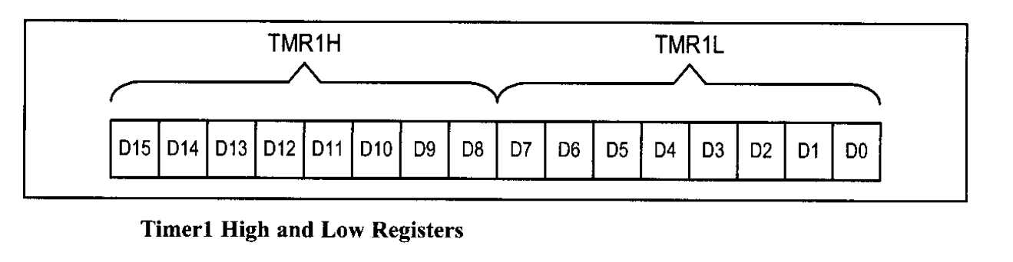

Slide 3

Timer 1 control register – T1CON
D7 D6 D5 D4 D3 D2 D1 D0 not used

Slide 4
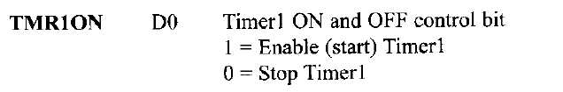
Timer 1 control register – T1CON
D7 D6 D5 D4 D3 D2 D1 D0 not used

Slide 5

Timer 1 control register – T1CON
D7 D6 D5 D4 D3 D2 D1 D0 not used

Slide 6
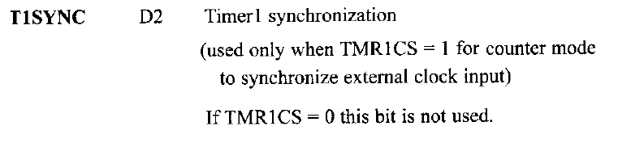
Timer 1 control register – T1CON
D7 D6 D5 D4 D3 D2 D1 D0 not used
1 = Do not synchronize external clock input
0 = Synchronize external clock input

Slide 7

Timer 1 control register – T1CON
D7 D6 D5 D4 D3 D2 D1 D0 not used

Slide 8
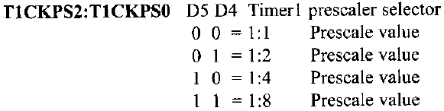
Timer 1 control register – T1CON
D7 D6 D5 D4 D3 D2 D1 D0 not used

Slide 9

Timer 1 control register – T1CON
D7 D6 D5 D4 D3 D2 D1 D0 not used

Slide 10
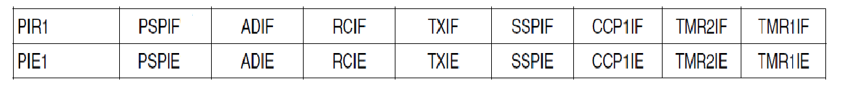
PIR1 and PIE1 registers
Peripheral Interrupt Request 1 register
TMR1IF → Timer 1 Interrupt Flag
Peripheral Interrupt Enable 1 register
TMR1IE → Timer 1 Interrupt Enable

Slide 11


Slide 13
0 0 1 1 0 0 0 0 = 30H

Slide 14
Given XTAL = 10 MHz
Frequency of square wave = 50Hz
Period = 1/50 = 200 ms
Time delay t = Period / 2 = 100 ms = 10⁴ µs
f = 10 MHz
n = t*f/(4*8) = 3125
c= 65536 – 3125 = 62411
Convert c to Hex ➔ F3CB
Set TMR0H and TMR0L

Slide 15
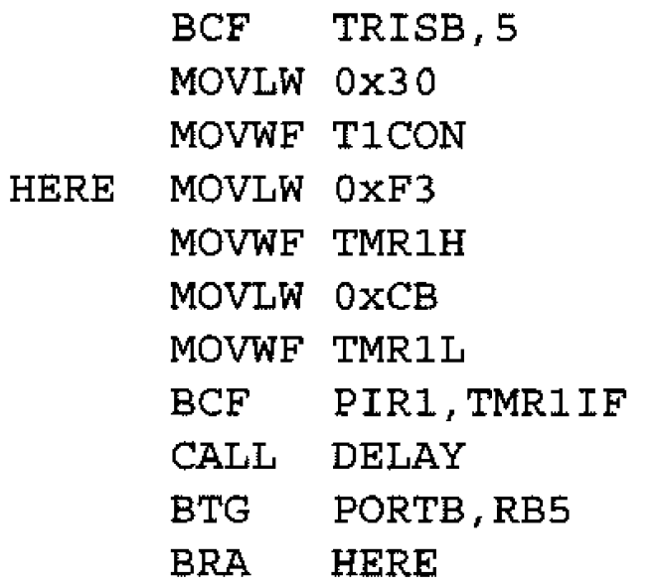

Slide 17
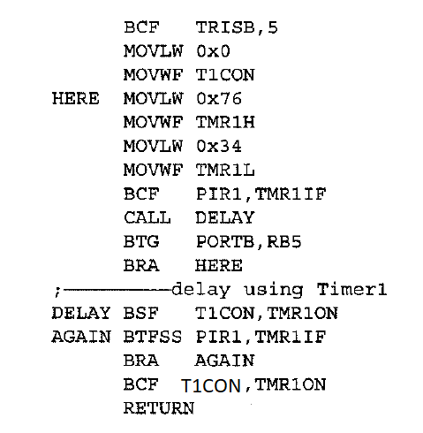

Slide 18
Timer frequency = crystal frequency/4 = 10/4= 2.5MHz.
Each clock period = T = 1/2.5MHz = 0.4µs
Time delay= number of counts * clock period
Number of counts = FFFFH – 7634 +1(rolling back)
= 89CBH (35275 decimal)
Time delay(half cycle) = 35275* 0.4 = 14.110 ms
Time delay(full cycle) = 14.110 *2 = 28.220ms
Smallest Frequency of square wave = 1/Time of full cycle = 35.43 Hz

